Slide 1
Automatically Adjusting Game Difficulty Via a Wearable Device
By: Robert Jackson
Faculty Mentor: Professor Dvijesh Shastri
Committee Members:
Professor Kenneth Oberhoff
Professor Mitsue Nakamura

Slide 2
Topics
Introduction
What is the research?
Why do it?
Past research
E4 wristband
Hypothesis
Game design
Basic design
Difficulty metrics
Difficulty settings for testing
Experimental design
The phases
Data collection
Conclusion
Summary
What’s next?
Questions
Results discussion
What does it mean?

Slide 3
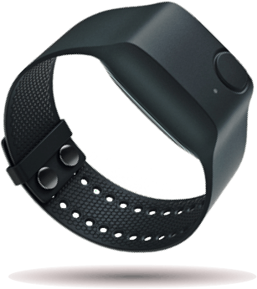
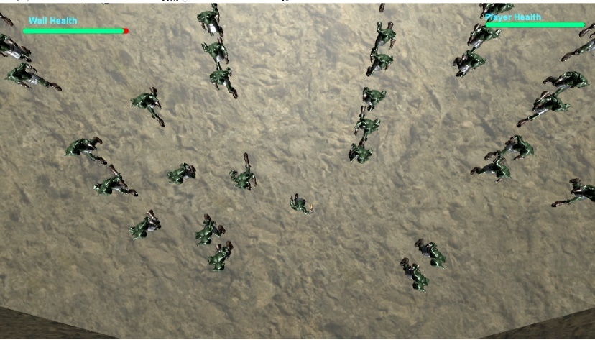
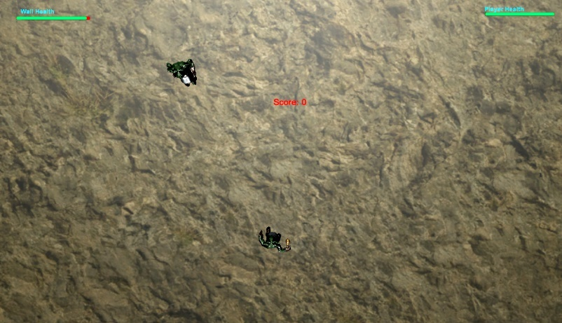

Introduction: What is the Research?
Using
Can we make
Become
Before
And vice versa

Slide 4
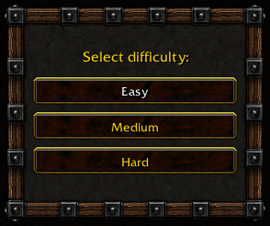
Introduction: Why Do it?
+
How games have been traditionally played
What we want
Choose a difficulty setting
Game adjusts difficulty for higher enjoyment

Slide 5
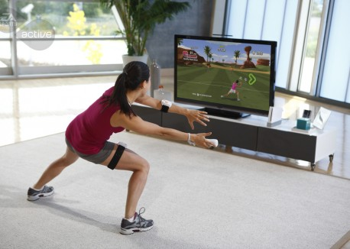
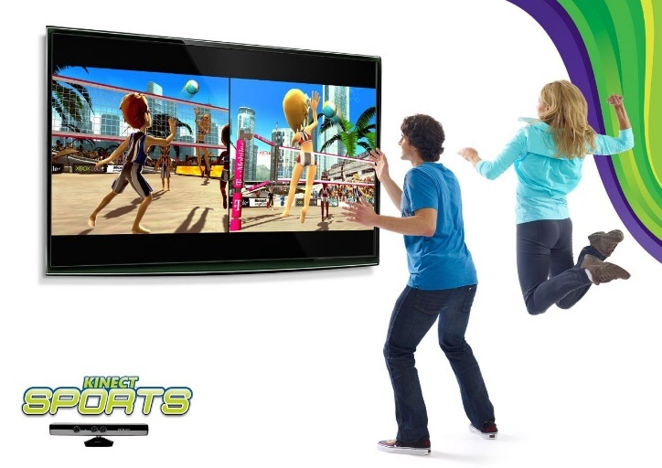
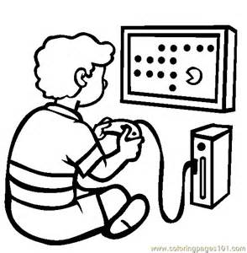
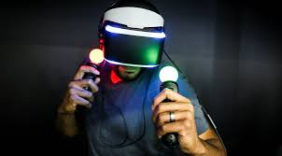
Introduction: Why Do it?
+
How games have been traditionally played
Growing Trend

Slide 6
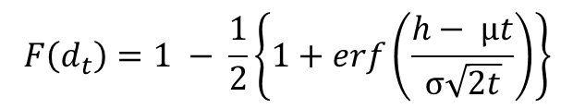
Introduction: Past Research
( ) 1 1 1 2 2 t
h t
F d erf
t
m
s
ì æ - öü = - í + ç ÷ý
Game difficulty adjustments based on performance
Hunicke’s Study [1]
Sampayo-Vargas et al [2]
Resources in game controlled based off performance algorithm
Educational game, difficulty dynamically alters between levels
$$F\left(d_{t}\right)=1 − \frac{1}{2}\left\{1+erf\left(\frac{h− µt}{σ\sqrt{2t}}\right)\right\}$$
The problems
Dynamic adjustment based on algorithm
Performance does not indicate engagement
The problem
Dynamic change not real time. It occurs between levels.
[1]Hunicke, R. 2005. The Case for Dynamic Difficulty Adjustment in Games. In Proceedings of the 2005 ACM SIGCHI International Conference on Advances in computer entertainment technology,(2005), 429-433.
[2]Sampayo-Vargas, S., Cope, C., He, Z., Byrne, G. 2013. “The effectiveness of adaptive difficulty adjustments on students’ motivations and learning in an educational computer game,” Computers & Education 69(November, 2013): 452-462, accessed October, 2016. Doi: 10.1016/j.compedu.2013.07.004

Slide 7
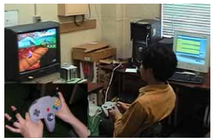
Introduction: Past Research
Game difficulty adjustment: Based on affect
me output was recorded in order to synchronize it with the screen showing physiological data. An experimental scene is shown in Figure 2. Figure 2: An experimental scene
Lin and Hu’s study [3]
Yun et al’s study[4]
Demonstrated correlation between galvanic skin response and frustration while playing video game
Successfully created algorithm to dynamically adjust video game difficulty based on physiological data.
The problems
Player restricted by sensors on fingers.
Movement caused noise in data.
The problems
Stress cam is much too expensive for regular use.
Requires user to be sitting directly in front of the cam.
[3]Lin, T., Omata, M., Hu, W., and Imamiya, A. “Do physiological data relate to traditional usability indexes?” Proceedings of the 17th Australia Conference on Computer-Human interaction: Citizens online: Considerations For Today and the Future, Canberra, Australia, November 21 - 25, 2005
[4] Yun, C., Shastri, D., Pavlidis, I., Deng, Z. 2009. “O’ game, can you feel my frustration?: Improving User’s Gaming Experience via StressCam.” In Proceedings of the 27th international Conference on Human Factors in Computing Systems. 2195-2204.

Slide 8
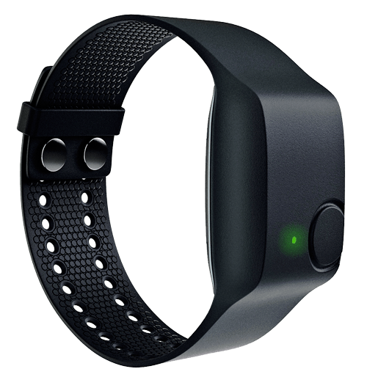
Introduction: Past Research
Solution?
A wireless wearable device designed to filter data based on movement to reduce or eliminate noise
E4 wristband by Empatica

Slide 9
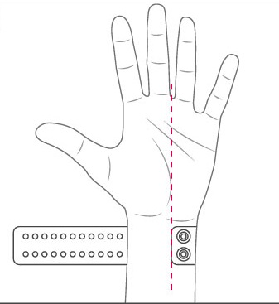

Introduction: E4 Wristband
What is it?
Wrist device with various sensors that measures physiological arousal levels in real time
How to obtain the data?
Recorded then uploaded
Recorded in real time using a Mac or PC to get specific data during real time
Recorded in real time using iPhone or Android

Slide 10
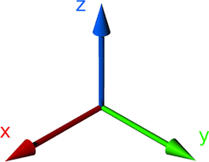
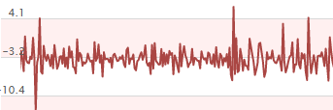
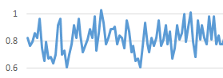
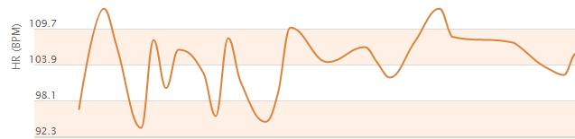
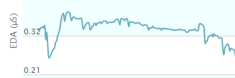
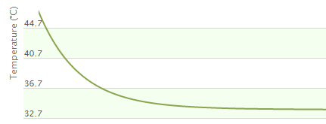
Introduction: E4 Wristband
What data does it provide?
Accelerometer in the x, y and z axis
Blood Volume Pulse(BVP)
Interbeat Interval(IBI)
Heart Rate(HR)
Electrodermal readings(EDA)
Temperature(Celsius)

Slide 11
Introduction: Hypothesis
When game difficulty increases, there will be a marked increase in arousal levels
The above trends will consistently prove to be the norm in data collection
There will be a correlation between enjoyment and arousal levels

Slide 12
Game Design: Basic Design
Goblin Assault
Goblin Invaders
Galaga meets tower defense
Our Hero
Defend the wall
If hero or wall runs out of health, game over

Slide 13
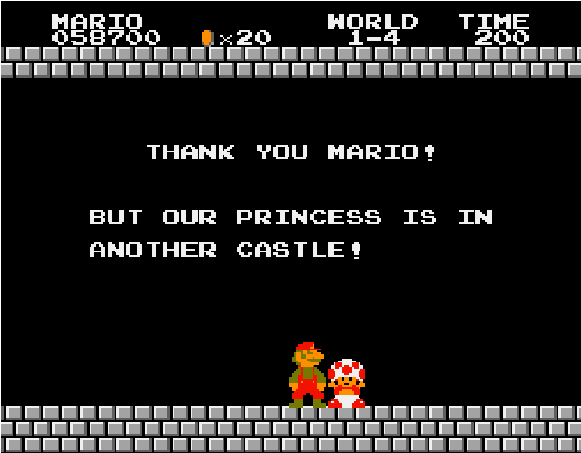

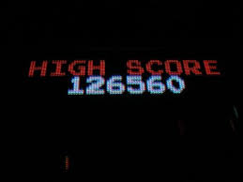
Game Design: Difficulty Metrics
What is game difficulty?
Difficulty is the challenges a player must overcome to obtain their reward
What is the reward?
Beating the game
Satisfaction for completing a hard challenge
Achieving a high score

Slide 14
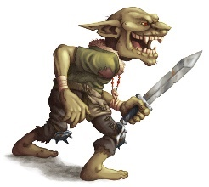
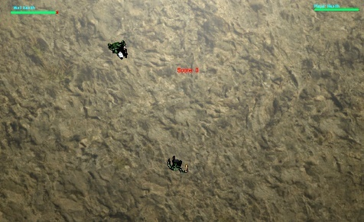

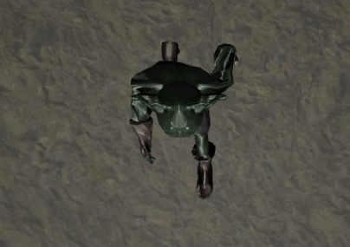
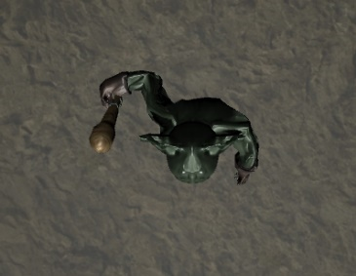
Game Design: Difficulty Metrics
Difficulty Metrics for Goblin Assault
Speed of enemy goblin
Number of goblins appearing at once
Frequency of types of goblins appearing

Slide 15
Game Design: Difficulty Settings For Testing
Difficulty Metric | Easy Mode | Hard Mode
Speed | Values: 1 to 3 Average increments of .5 | Values: 1 to 4 Increments of 1
Rate of appearance(in seconds) | Values: 3 to 2 Average increments of .1 One at a time | Values: 2 to 1.5 Average increments of .1 1 to 2 at a time
Frequency of goblin warrior appearing | From not at all to as often as goblin charger. | From as often as goblin charger to predominantly appearing.

Slide 16
Experimental Design: Phases
Rest 1
Easy Difficulty
Rest 2
Hard Difficulty
Ten minutes listening to relaxing music
Reduces or removes stress from system
Establishes baseline for subjects’ physiological data
Allows player to get used to game controls.
Gives a base set of gameplay data to compare to hard mode.
Fill out survey at the end.
Ten minutes listening to relaxing music
Reduces or removes stress from system
Establishes new baseline for subjects’ physiological data
Designed to defeat a player within three minutes of play time.
Aim is to frustrate player to show arousal in physiological data.
Fill out survey at the end.

Slide 17
Experimental Design: Demo
A brief demo to demonstrate how data is being collected as a subject is playing the game.
Eloy will be subjected to his own creation: Hard Difficulty

Slide 18
Results Discussion: The Data
Unusable Data
Blood Volume Pulse (BVP) | Primarily used to derive HR and IBI Data constantly oscillating
Interbeat Interval(IBI) | Data Collection inconsistent
Temperature | Data trends opposite of EDA. EDA data was sufficient

Slide 19
Results Discussion: Heart Rate
P Value Comparison Rest 1 Easy Rest 2 Hard
Rest1
Easy 0.455322237
Rest2 0.246098555 0.285869987
Hard 0.272711721 0.299026806 0.21700606
P-Value: .299027

Slide 20
Results Discussion: Electrodermal Activity
P Value Comparison Rest 1 Easy Rest 2 Hard
Rest1
Easy 0.455322237
Rest2 0.246098555 0.285869987
Hard 0.272711721 0.299026806 0.21700606
P-Value: .10712801

Slide 21
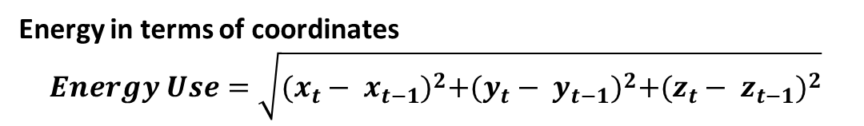

Results Discussion: Energy
P Value Comparison Rest 1 Easy Rest 2 Hard
Rest1
Easy 0.455322237
Rest2 0.246098555 0.285869987
Hard 0.272711721 0.299026806 0.21700606
Energy in terms of coordinates
$$Energy Use=\sqrt{{(x_{t}− x_{t−1})}^{2}+{(y_{t}− y_{t−1})}^{2}+{(z_{t}− z_{t−1})}^{2}}$$
P-Value: .229605

Slide 22


Conclusion: Summary
Is there data where arousal of hard difficulty is higher than easy difficulty?
Is the data consistent?
P-Value: .10712801
Is there a correlation between enjoyment levels and physiological arousal?

Slide 23
Conclusion: What’s Next?
Future Work:
Game refinement and adding difficulty level
More studies to further evaluate EDA, HR and Energy use
Potential creation of dynamic algorithm

Slide 24



Acknowledgements
I would like to give my deepest thanks to
Professor Kenneth Oberhoff
Professor Dvijesh Shastri
Professor Mitsue Nakamura
Eloy Perez
All who participated in data collection
Professor Sangeeta Gad

Slide 25
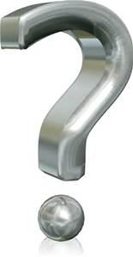
Questions?

